Slide 1









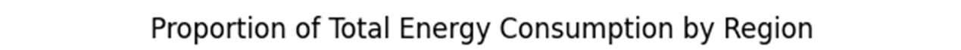
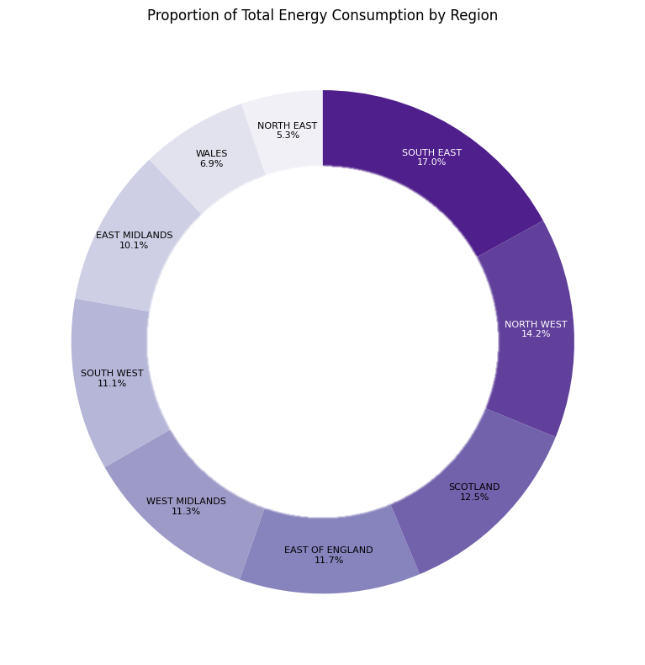
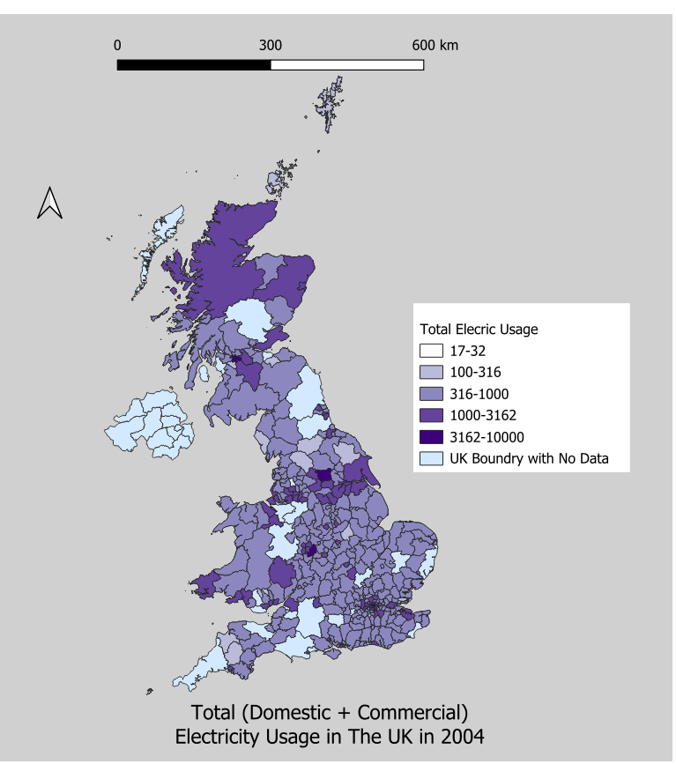
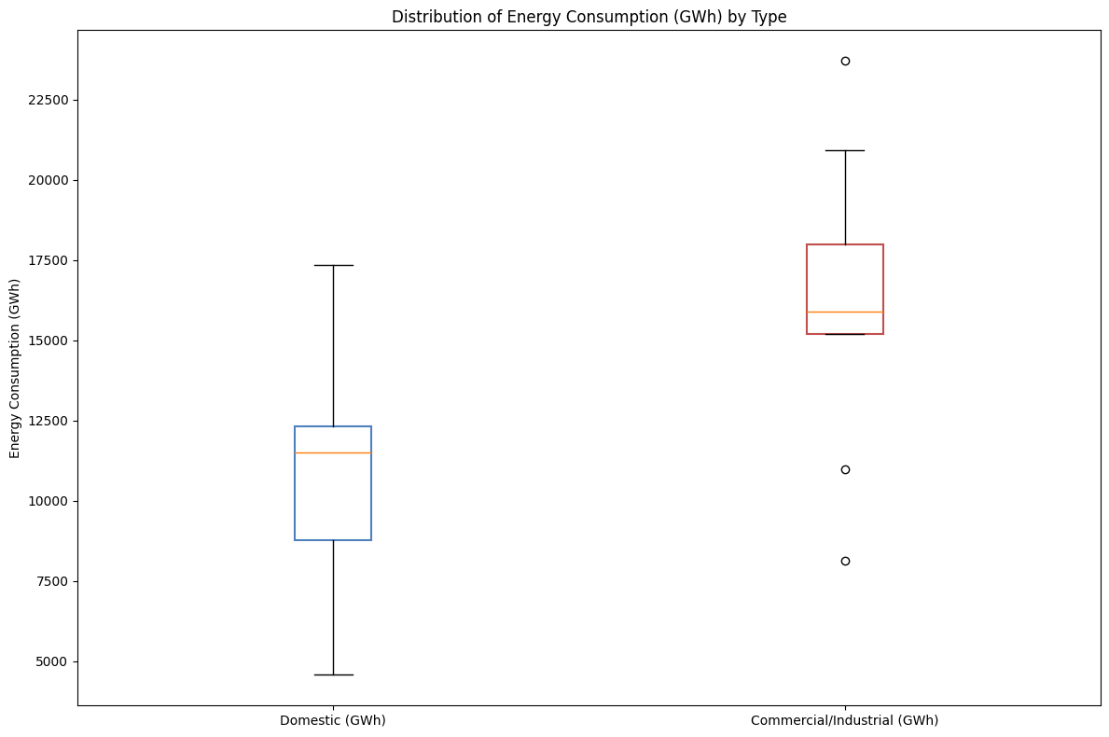
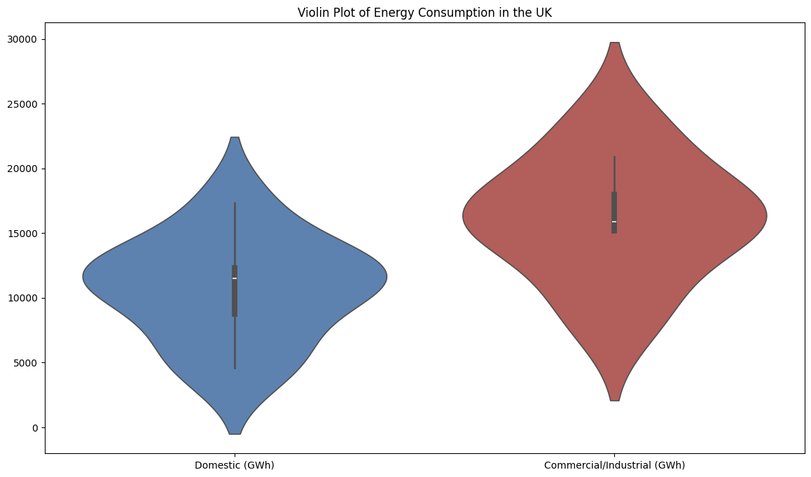
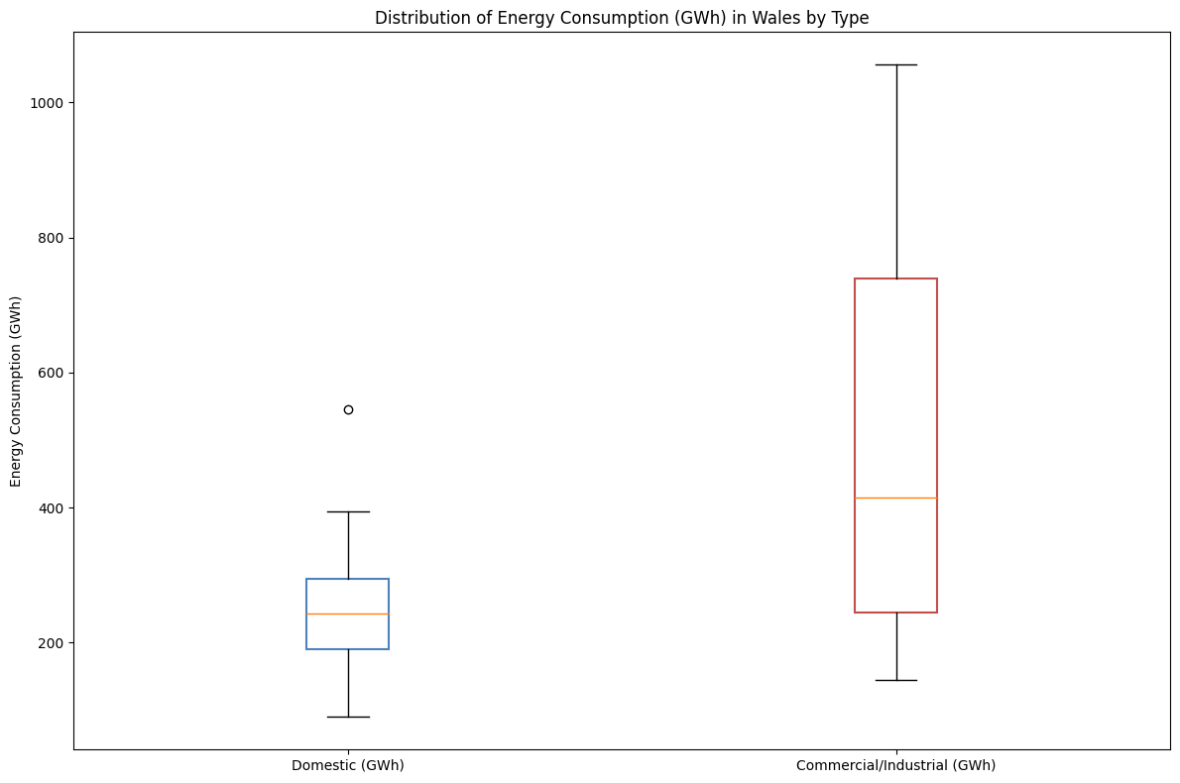
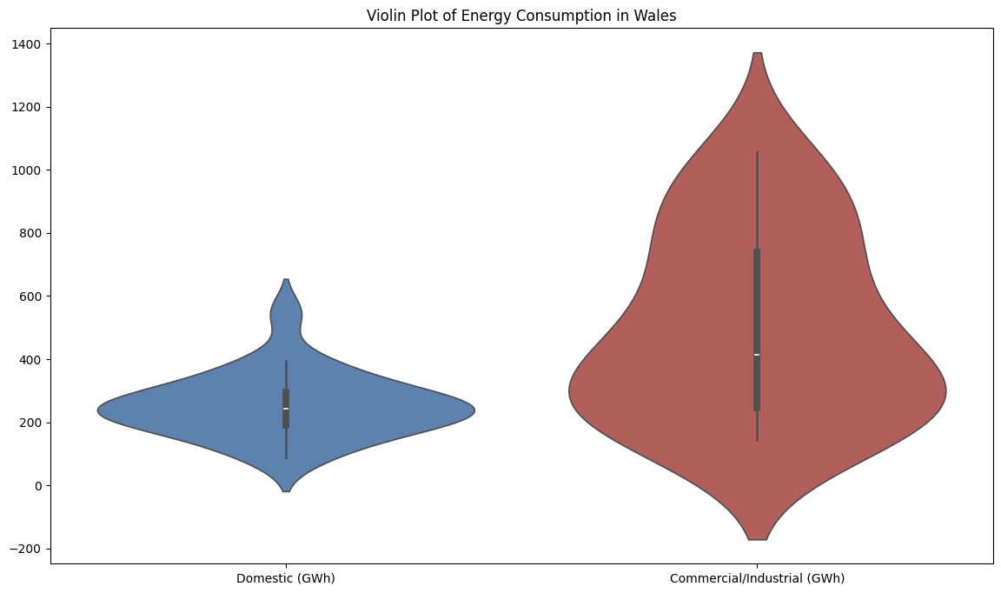

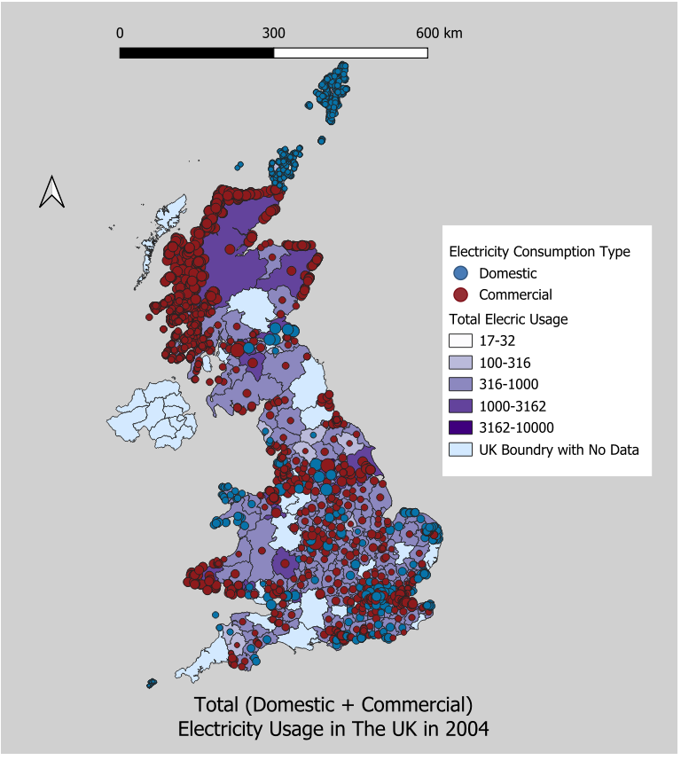
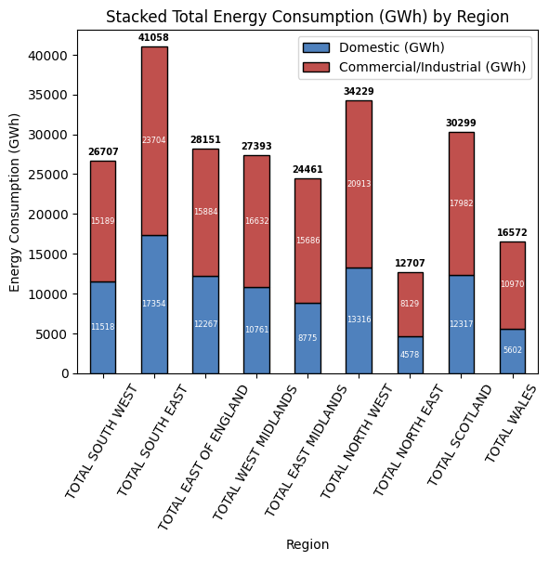
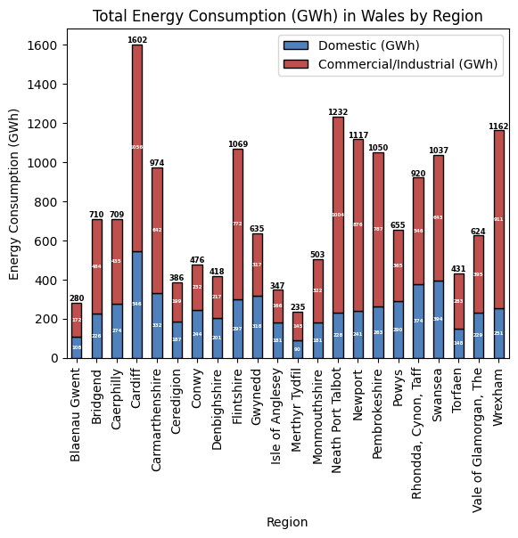
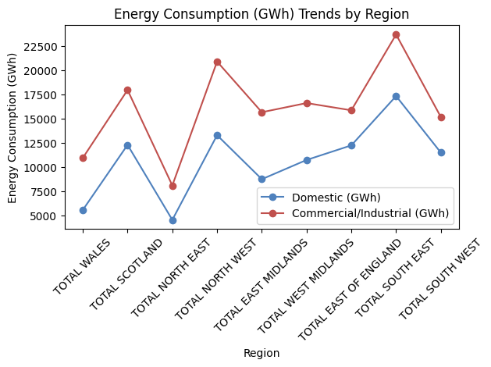
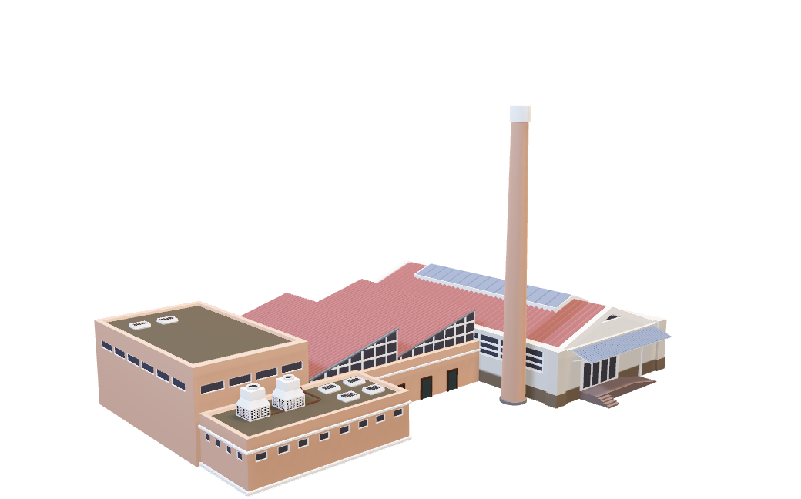

Electric Consumption Analysis: UK-Wide Commercial vs Domestic Usage, Regional Insights, and Wales Focus
NOTE: Electricity usage measure are in Giga Watts per Hour (GWh)
Energy
Reza Foratikashani
969477@swansea.ac.uk
INDUSTRIAL
Usage Across the UK | Aggregated Regional Data Analysis | Detailed Study of Wales (Cymru)
Box Plots:
Display data distribution through quartiles.
Show the median and highlight potential outliers.
Offer a clear overview of data spread but limited distribution shape detail.
Violin Plots:
Combine box plot features with kernel density estimation.
Provide a comprehensive view of data distribution, including frequency variations.
A comparison between the overall UK and Wales shows that, while industrial usage is higher in both regions, Wales has a larger gap between industrial and domestic usage.
Distribution of Energy Consumption(GWh) by Type
Violin Plot of Energy Consumption (GWh) by Type
Distribution of Energy Consumption(GWh) in Wales by Type
Violin Plot of Energy Consumption (GWh) in Wales by Type
Box plots and violin plots clearly illustrate that commercial/industrial usage is greater than domestic usage. The box plot for commercial/industrial usage reveals outliers at both the higher and lower ends of the data.

